Slide 1
Adept x SUMO Semester 1 Hackathon
Notes:
https://us02web.zoom.us/j/86355386399?pwd=ZOgZHHr80jfMU3EKAKcBH1_UsPXSQr.1

Slide 2
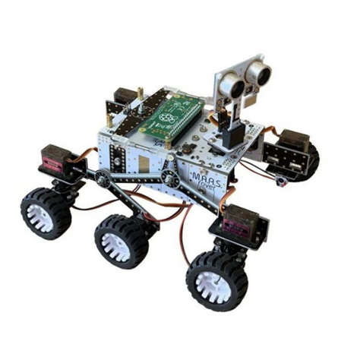
Overview
The hackathon will require you to program and interface with a Raspberry Pi Zero W and replica Mars rover system to navigate through two stages of Mars-like environments.
All code must be programmed in Python and teams are free to use the included rover.py library as well as any other libraries required.
Your submission will be two .py files run separately for each stage.
Notes:
http://4tronix.co.uk/rover/rover.py

Slide 3
Stages
1. Predetermined Route
2. Unseen Environment
You’re given a predetermined route to navigate the rover through
You will be given the exact dimensions of the route.
All edges of the route will have walls to allow the sonar to detect distances.
There will be a large time penalty for collisions so accuracy is key.
There will also be a small time penalty for each user input. Minimum user input is desired but manual inputs are also recommended.
The second stage will involve testing your rovers in an unseen environment.
You’ll encounter new obstacles and terrain.
This task is more focussed on autonomy so collisions will have a smaller time penalty while user input will incur a larger time penalty.
Note: We are aiming for full autonomy through the course to get maximum points but it is recommended that user control is allowed as a failsafe.

Slide 4
Scoring
The two stages will be scored based on the time of completion.
Speed is the goal here, the group with the fastest system will win, however time penalties will be applied for the following;
Collisions: Each collision with walls or obstacles
Excess User Input: The aim is for rover autonomy so user inputs after the start will incur time penalties.
The time penalties for any of these errors will be dependent on the stage and will be outlined in the stage descriptions of the brief.

Slide 5
Hardware available on the Rovers
Raspberry Pi Zero W
6 drive system motors (3 controlled for left and 3 for right)
5 servo motors
4 servos on the 4 corner wheels to allow for counter phase steering
1 servo connected to the sonar sensor
Sonar
Camera module (can be connected if required)

Slide 6
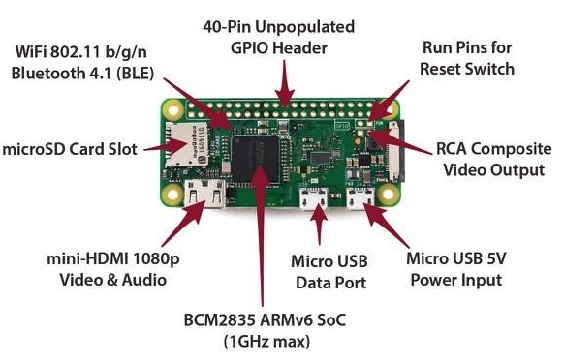
Core System Architecture: Microcontrollers
A microcontroller contains a CPU which executes code stored on a generally small amount of rewritable ‘flash’ memory. The code on this memory can be updated or replaced by ‘programming’.
Code written for a microcontroller will generally use the onboard analog and digital input/output pins to interface with external hardware such as motors or sensors.

Slide 7
Interfacing with the Raspberry Pi
SSH
SSH, also known as Secure Shell or Secure Socket Shell, is a network protocol that gives users, particularly system administrators, a secure way to access a computer over an unsecured network.
When the Pi is on run the following line from the terminal on a device connected to the same network as the pi, replace the numbers with the appropriate IP:
ssh adept@123.456.78.90
Enter the password adept when prompted.
This will enable users to directly connect to the command line of the raspberry pi. From the command line, bash commands can be used to navigate directories, run and lightly edit files. This is by far the fastest way to interface with the board.

Slide 8
Interfacing with the Raspberry Pi
2. VNC
VNC or Virtual network Computing is a screen sharing system that allows users to remotely control another computer. This means that a computer’s screen, keyboard, and mouse can be used from a distance by a remote user from a secondary device as though they were sitting right in front of it.
Download VNC viewer on your PC from here:
https://www.realvnc.com/en/connect/download/viewer/
You will be required to create an account then you can enter the Raspberry Pis IP address to connect. The username and password are both adept.
This will enable users to connect to the Raspberry Pi OS desktop environment and navigate through the GUI. This is a good option for people who aren't comfortable with only using a command line interface.

Slide 9
Interfacing with the Raspberry Pi
3. Direct
The Raspberry Pi can be interfaced directly through a mouse, keyboard and monitor.
Connect a monitor and keyboard/mouse directly to the board using the adaptors. Only recommended if you are experiencing network problems. This may be unstable if the board is powered by the rover batteries, so only run this when it is USB-powered. Not recommended if either of the other two options are available.

Slide 10
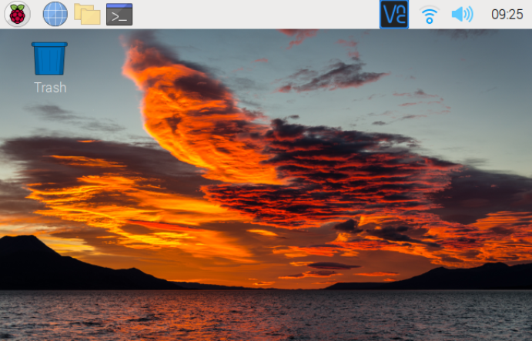
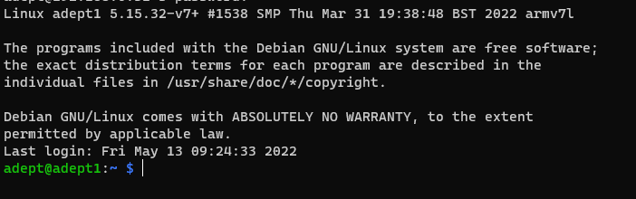
Navigating the Linux Terminal
Raspberry Pi is run on an Arm based processor and runs linux
The Raspberry Pi OS has a desktop environment that you’ll be familiar with
Navigating the console is very important especially for SSH connection
Raspberry Pi OS Desktop Environment
SSH Console Terminal

Slide 11
Basic Bash Commands
Change directory
List Files
Delete file
/directory
Run code
Changes the current directory of the terminal
cd <directory>
cd (move back to previous directory)
Lists the files in the current directory
ls
rm <filename>
rm -r <directory>
python <filename>.py

Slide 12
Basic Bash Commands
Edit text files
Find IP of Device
Transfer files
Transfer directory
nano <filename>
Prints the IP address of the PI (most likely not needed)
Hostname -I
Transfers a files or files to the Pi
scp <localfilepath> adept@123.456.78.90:marsrover/
Transfers entire directory to the Pi
scp -r <localdirectorypath> adept@123.456.78.90:marsrover/

Slide 13
Programming for the Rover
All rover programs are written in python
The rover.py library has the main functions required to interface with the hardware.
You are also given the example programs that you can base your own code off
calibrateServos.py - sets servo offsets
motorTest.py - tests which servo is connected to which port
driveRover.py - allows you to manually control the rover
ledTest.py - cycles the rover LEDs through various colours
sonarTest.py - outputs the distance in front of the sonar
Notes:
All the pre-loaded programs on the rovers are written in python, they are relatively simple to follow in the grand scheme of things, but obviously this depends on your previous experience in programming with python as well as microcontrollers.
The most important one is rover.py, this contains the basic functions for you to manipulate the rover’s movement and acquire data from the sonar sensor.
There are a number of other files listed on the screen that may be useful. The people who built these rovers are not brain surgeons, so some of the servos may be misaligned. Calibrate servos is a great place to start to adjust the servo offsets and make sure your rover goes where you actually want it to. The rest are fairly self-explanatory, and there are loads of comments within the code to explain what’s going on, but of course feel free to ask any questions. These files will be made available to you to download and view on your own machines should you wish to do so.

Slide 14
Any Questions?

